Slide 1



Feature Extraction Neural Networks for Quantum Kernel classifiers: low-energy background rejection in Xenon-Doped LArTPC detectors ​
UNIVERSITÀ DEGLI STUDI DI MILANO - BICOCCA
Scuola di Scienze
Dipartimento di Fisica «Giuseppe Occhialini»
Corso di Laurea Magistrale in Fisica
Relatore: dott. Andrea Giachero
Correlatore: dott. Daniele Guffanti
Relatore esterno: dott. Michele Grossi
Tesi di Laurea Magistrale
Roberto Moretti
Matr. 825617
Anno Accademico 2021/2022 – Sessione di Ottobre

Slide 2

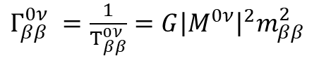
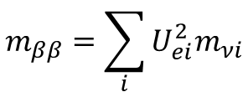
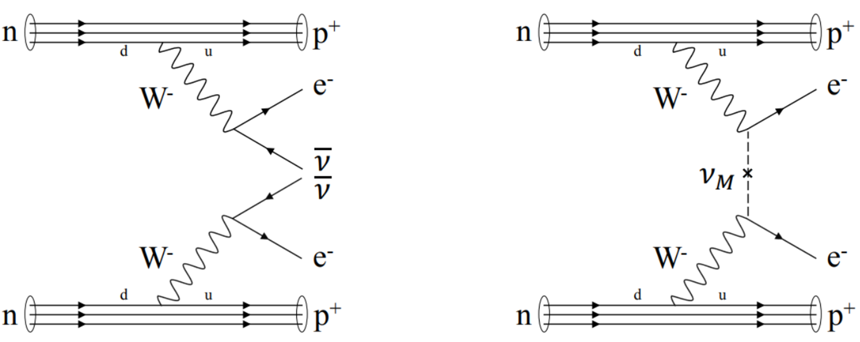
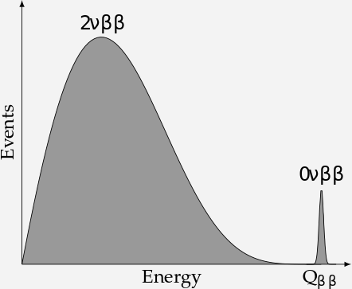
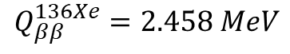
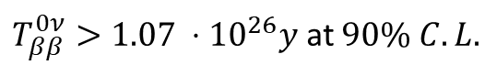
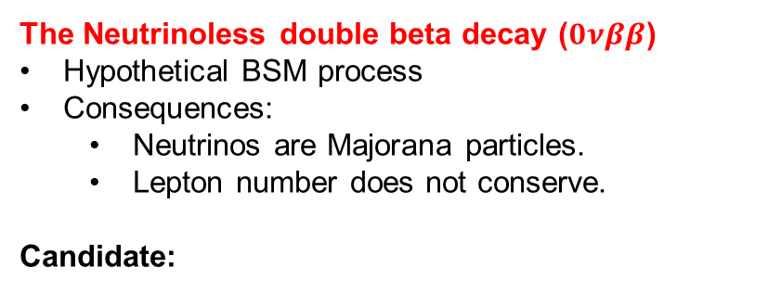
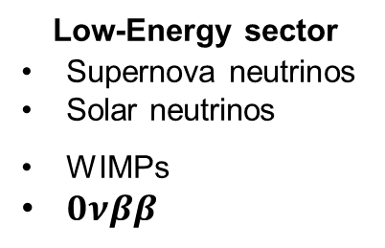
The 0νββ decay in DUNE
DUNE: Deep Underground Neutrino Experiment
Several physics goals:
Majorana mass
Low-Energy sector
Supernova neutrinos
Solar neutrinos
WIMPs
$0νββ$
High-Energy sector
Mass hierarchy
CP violation
Proton decay
phase space
nuclear matrix element
proposals
The Neutrinoless double beta decay ($0νββ$)
Hypothetical BSM process
Consequences:
Neutrinos are Majorana particles.
Lepton number does not conserve.
Candidate:
$$^{136}Xe_{54}→ ^{136}Ba_{56}+2e^{−}+2{\overline{ν}}_{e}$$
KamLAND-Zen, 2016, PhysRevLett.117.082503

Slide 3
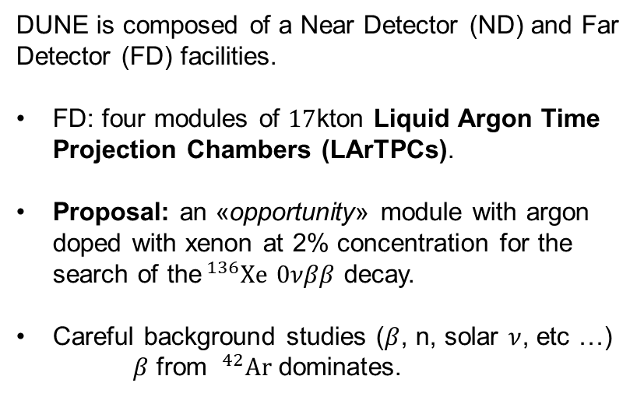
DUNE LArTPCs and Quantum Machine Learning
DUNE is composed of a Near Detector (ND) and Far Detector (FD) facilities.
FD: four modules of $17$kton Liquid Argon Time Projection Chambers (LArTPCs).
Proposal: an «opportunity» module with argon doped with xenon at 2% concentration for the search of the$^{136}Xe$ $0νββ$ decay.
Careful background studies ($β$, n, solar $ν$, etc …)
$β$ from $^{42}Ar$ dominates.
Thesis goal: leverage TPC tracking for background mitigation.
Challenging tasks at the MeV-scale in FD LArTPCs:
Opportunity to explore Quantum Machine Learning models (QML).

Slide 4
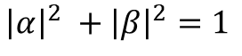
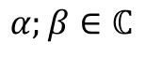

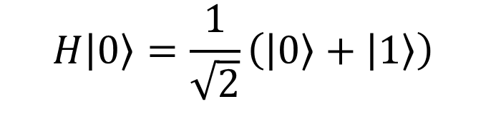
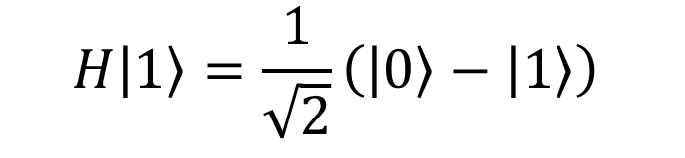

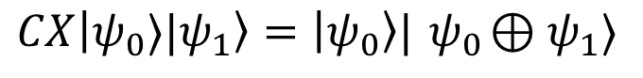

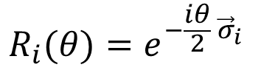
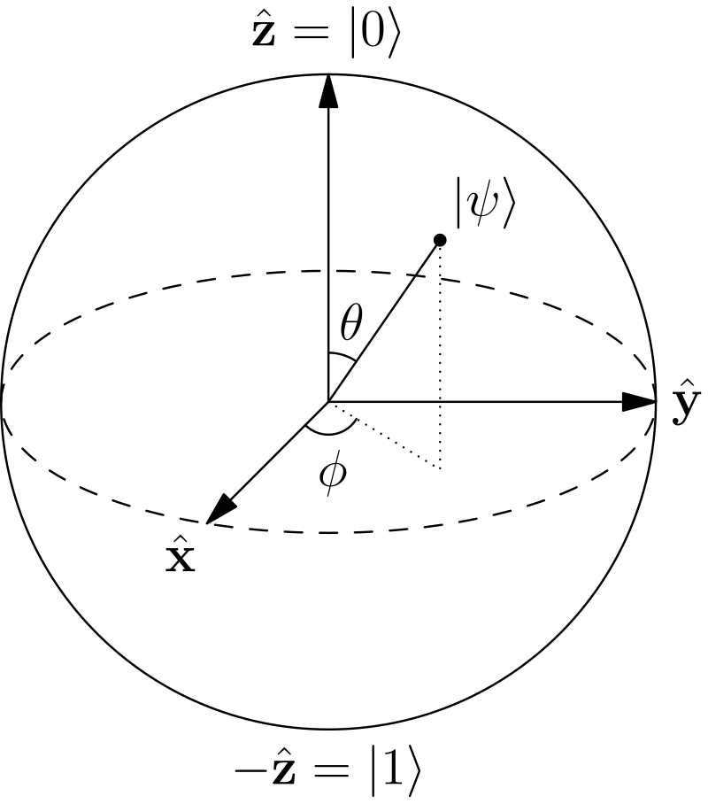
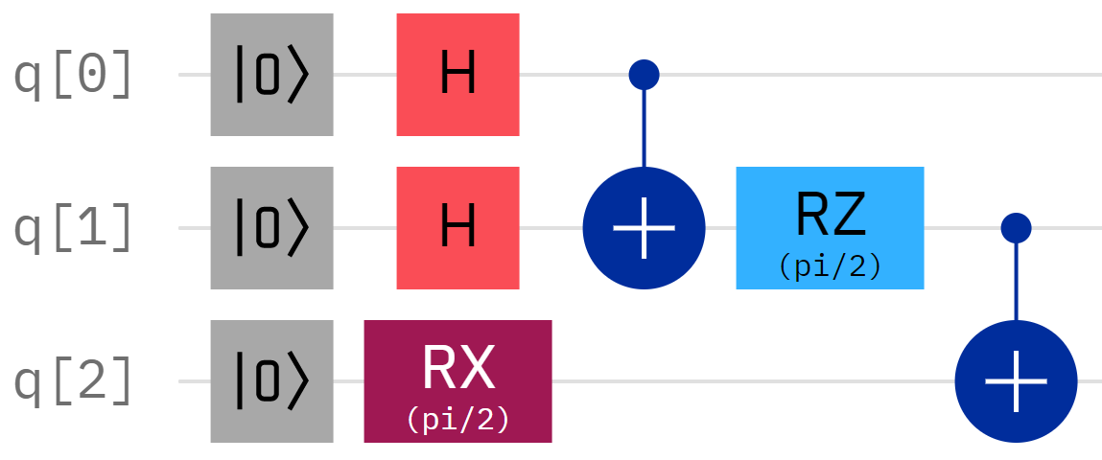
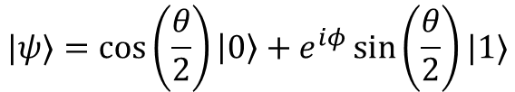
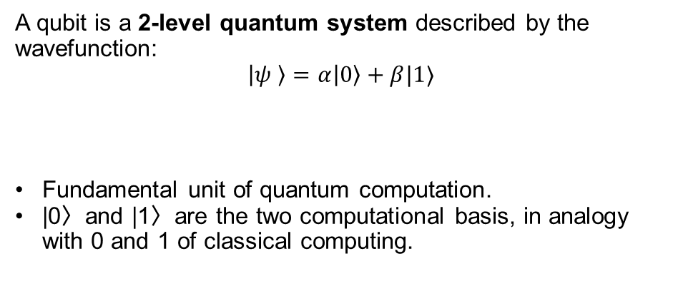
Qubits and Quantum Circuits
Qubits are controlled by unitary operators called quantum gates, organized in quantum circuits.
A qubit is a 2-level quantum system described by the wavefunction:
$$\left|ψ \right\rangle =α\left|0\right\rangle +β|1⟩$$
Fundamental unit of quantum computation.
|0〉and |1〉are the two computational basis, in analogy with 0 and 1 of classical computing.
Hadamard
CNOT
Pauli rotations
Qubit states can be visualized as points on a sphere’s surface.
Bloch Sphere representation
…
Entanglement

Slide 5
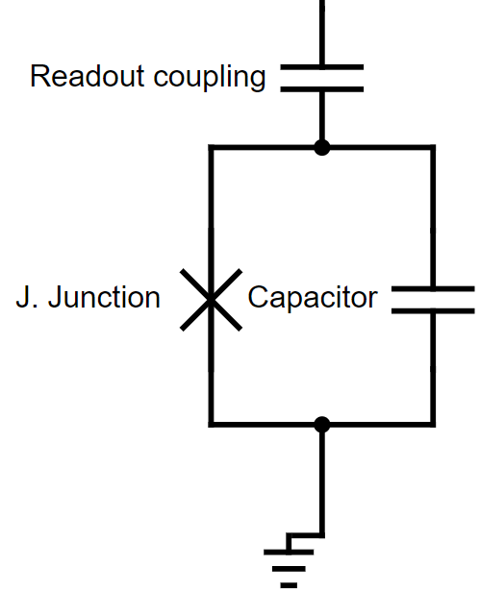
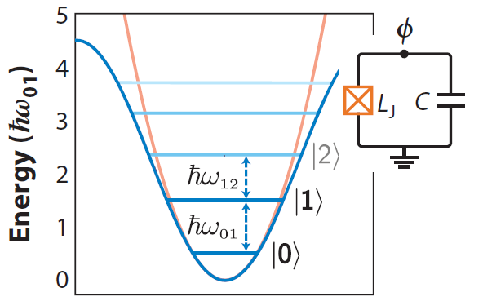
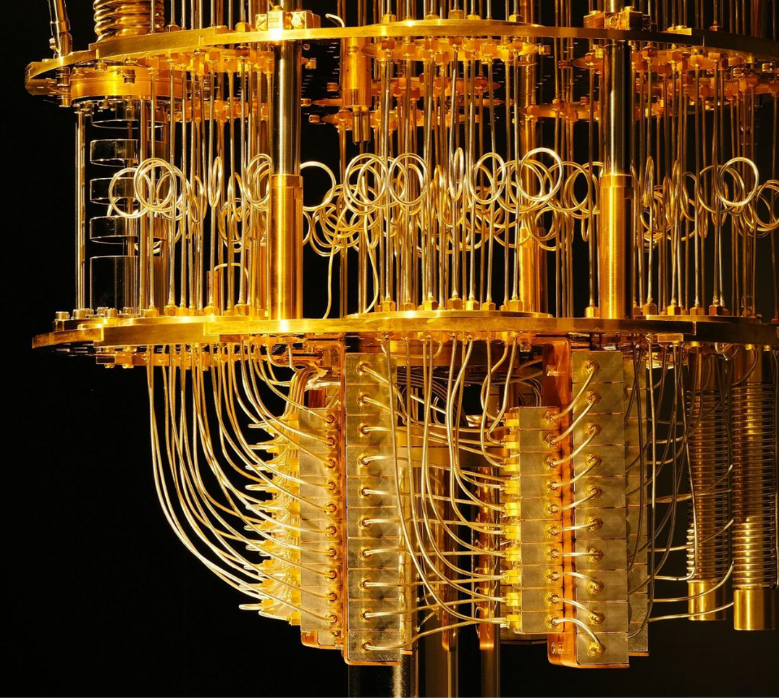
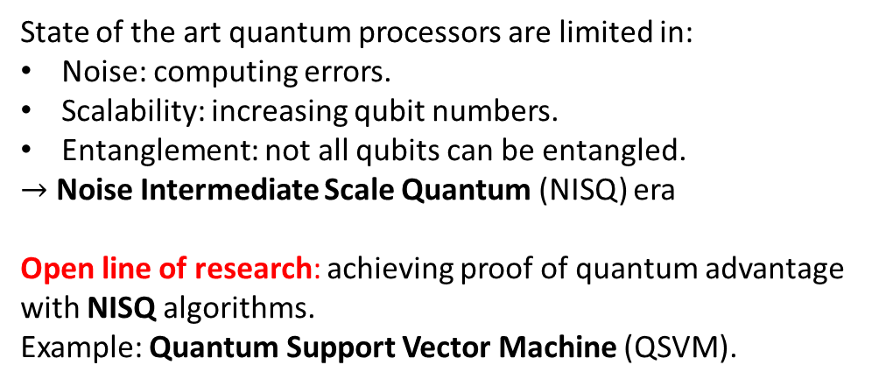

Superconductive qubit and NISQ era
Transmon: superconductive modified LC circuit.
The nonlinear inductance is called Josephson junction and allows for anharmonicity in the energy level separation:
Transmon
It’s possible to isolate ground and excited states as $|0⟩$ and $|1⟩$ bases.
State of the art quantum processors are limited in:
Noise: computing errors.
Scalability: increasing qubit numbers.
Entanglement: not all qubits can be entangled.
$→$ Noise Intermediate Scale Quantum (NISQ) era
Open line of research: achieving proof of quantum advantage with NISQ algorithms.
Example: Quantum Support Vector Machine (QSVM).
Eagle r1 quantum processor, the 127-qubits IBM quantum computer.

Slide 6
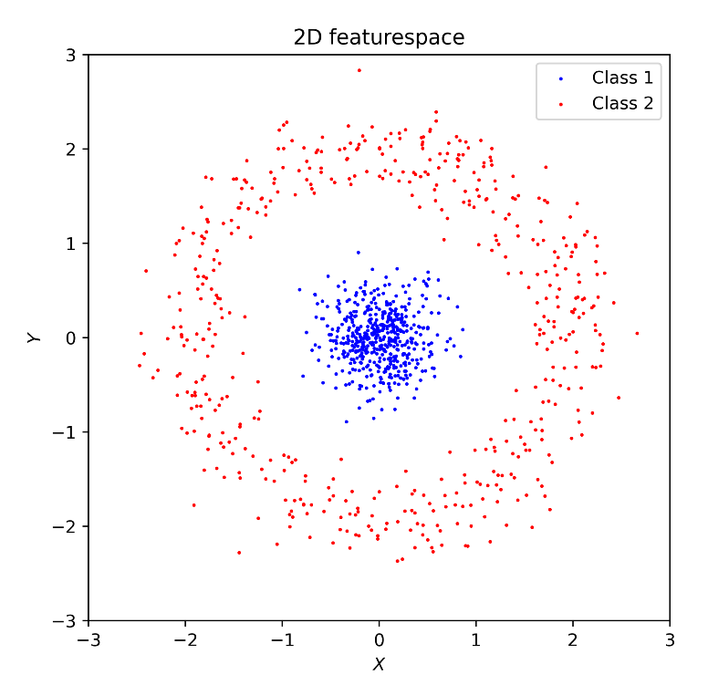
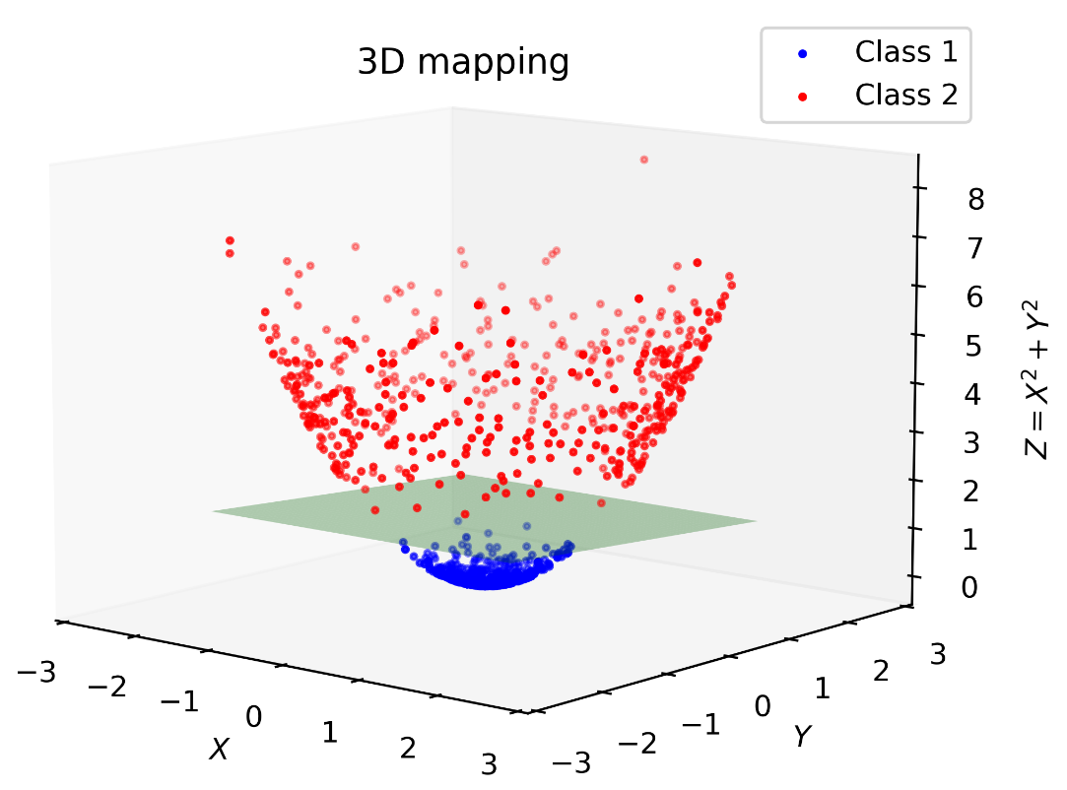
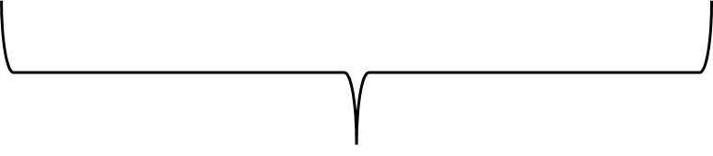
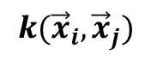
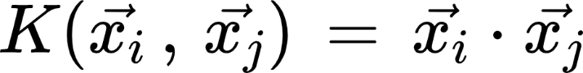
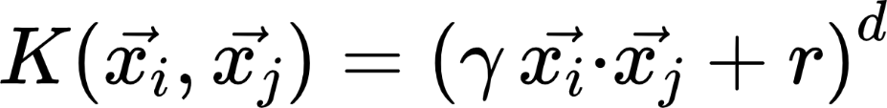
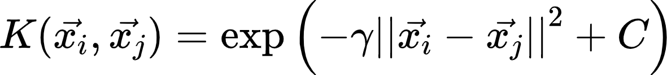
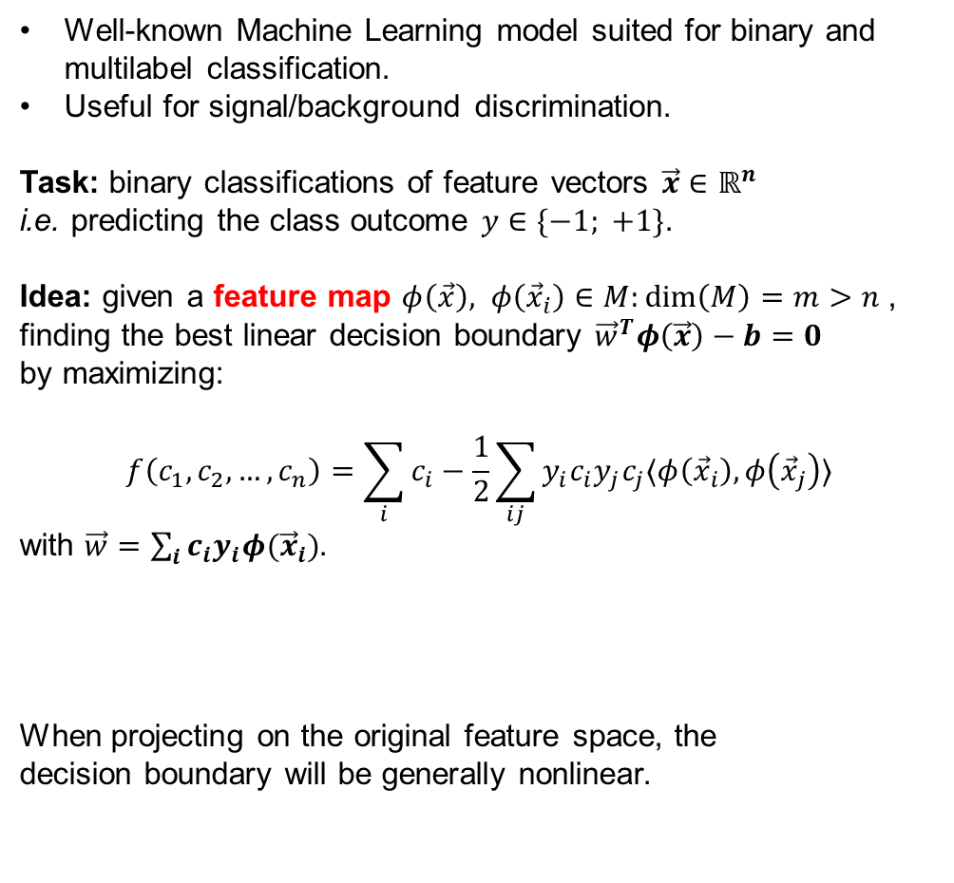
Support Vector Machine
Well-known Machine Learning model suited for binary and multilabel classification.
Useful for signal/background discrimination.
Task: binary classifications of feature vectors $\vec{x}∈ℝ^{n}$
i.e. predicting the class outcome $y∈\{−1; +1\}$.
Idea: given a feature map $φ\left(\vec{x}\right), φ\left({\vec{x}}_{i}\right)∈M:\dim\left(M\right)=m>n$, finding the best linear decision boundary ${\vec{w}}^{T}φ\left(\vec{x}\right)−b=0$
by maximizing:
$$f\left(c_{1}, c_{2}, …, c_{n}\right)=\sum_{i}{c_{i}}−\frac{1}{2}\sum_{ij}{y_{i}c_{i}y_{j}c_{j}〈φ\left({\vec{x}}_{i}\right), φ\left({\vec{x}}_{j}\right)〉}$$
with $\vec{w}=\sum_{i}{c_{i}y_{i}φ({\vec{x}}_{i})}$.
When projecting on the original feature space, the
decision boundary will be generally nonlinear.
Feature embedding
Common kernel choices:
Linear
Kernel function
Polynomial
RBF

Slide 7
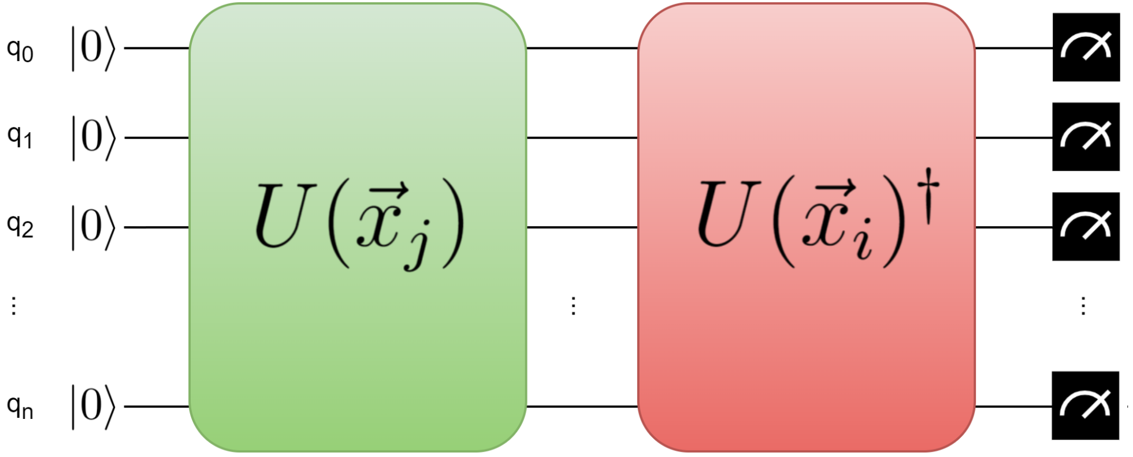
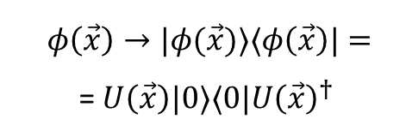
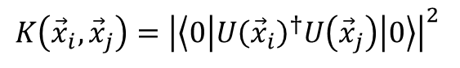
Quantum Kernel
Promoting the classical feature mapping to a quantum state:
Feature maps are still implicitly defined.
Kernel function is still a measure of similarity between different samples.
Quantum circuits of with this structure are suitable kernels.
Pros:
Hilbert space grows rapidly with qubit’s number
Expressive classifiers.
Quantum kernels are generally hard to compute classically
No classical counterpart.
Good results even with small sized circuits
Is a NISQ-era algorithm.
Cons:
Lack of featuremap explainability
Unintuitive relation between circuit and outcome.
Usually set arbitrarily
Problem of chosing a good Quantum Kernel.
Room for quantum advantage.

Slide 8
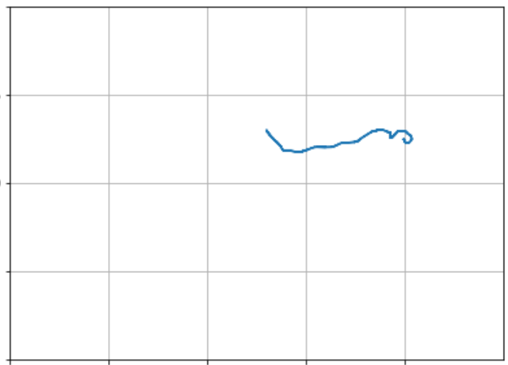

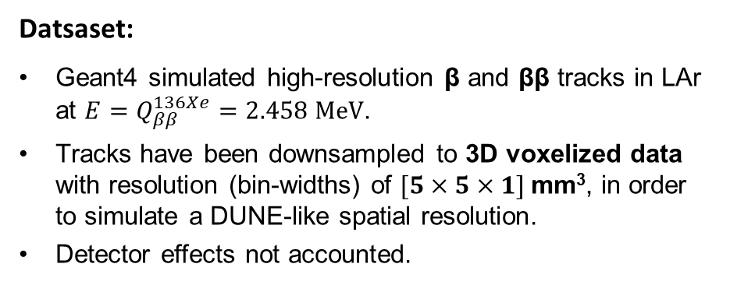
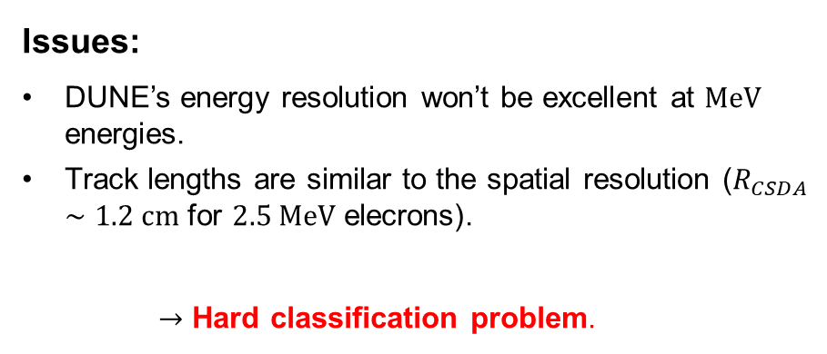
Toy model dataset
Datsaset:
Geant4 simulated high-resolution β and ββ tracks in LAr at $E=Q_{ββ}^{136Xe}=2.458 MeV$.
Tracks have been downsampled to 3D voxelized data with resolution (bin-widths) of $[5×5×1]$mm³, in order to simulate a DUNE-like spatial resolution.
Detector effects not accounted.
5 mm
Issues:
DUNE’s energy resolution won’t be excellent at $MeV$ energies.
Track lengths are similar to the spatial resolution ($R_{CSDA}∼1.2 cm$ for $2.5 MeV$ elecrons).
$→$ Hard classification problem.
“hit”
(XY) view (5 x 5) mm²

Slide 9
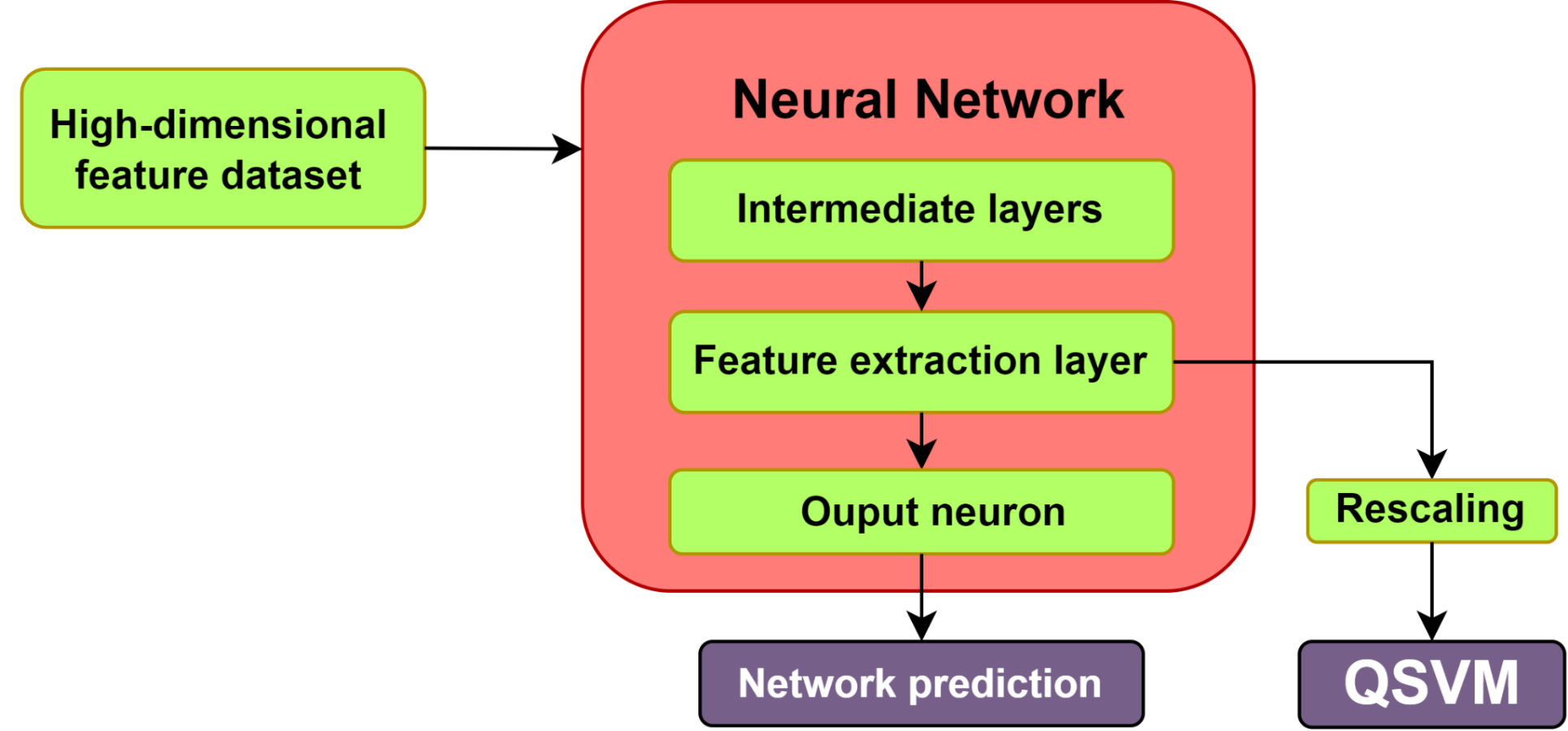
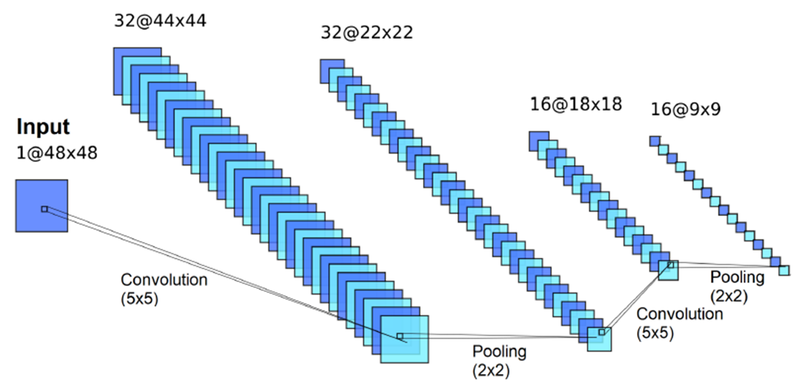
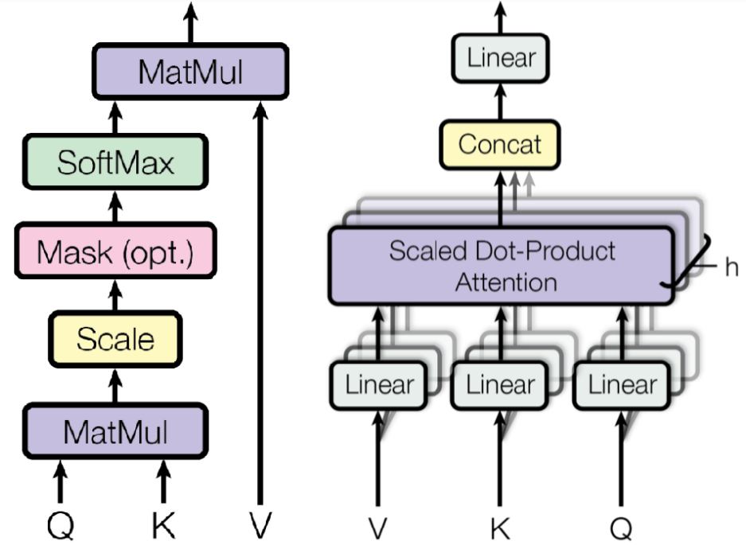
Feature extraction
For implementing the NISQ Quantum Support Vector Machine (QSVM) with LArTPC measurements, the input features must be reduced, while maintaining useful informative content.
Proposed approach: training Neural Networks as standalone classifiers, while defining specific feature extraction layers for the QSVM input.
Models investigated:
Convolutional Neural Network (CNN)
Tracks are elaborated visually and features are extracted making use of convolutional filters.
Transformer (or Attention Network) (ATN)
Tracks are treated as sequences of correlated hits, recurring to the mechanism of self-attention.
CNN
ATN

Slide 10
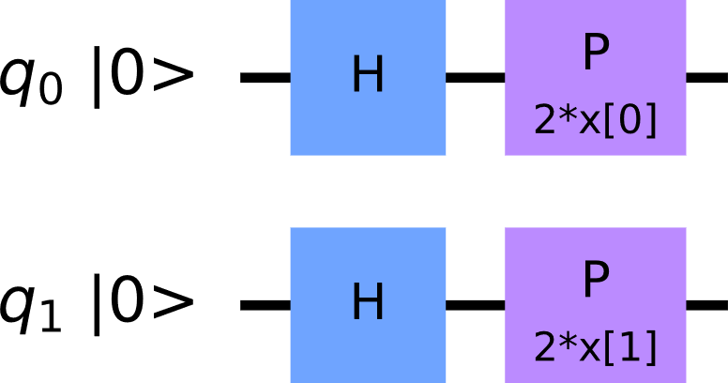
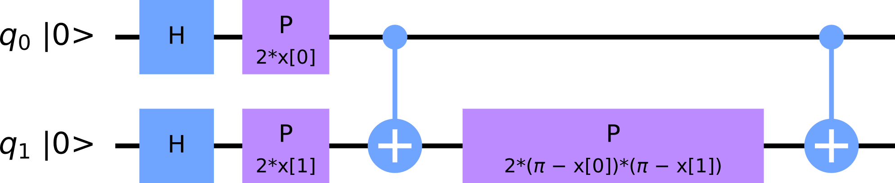
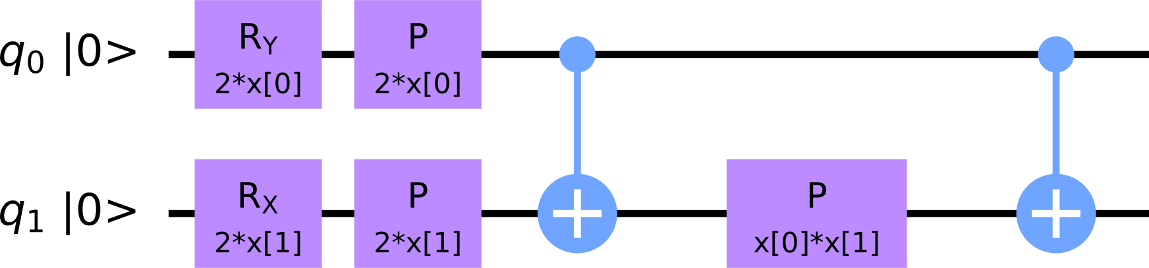
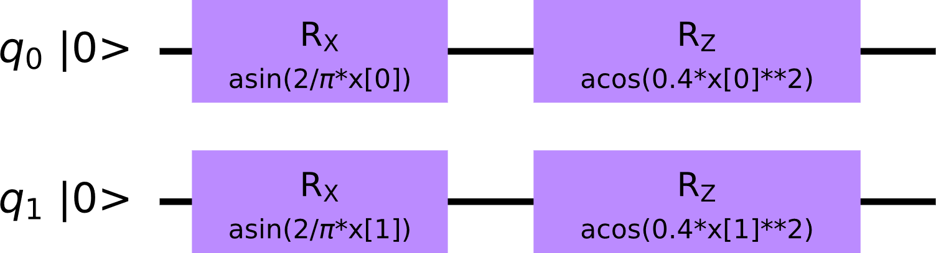
Quantum Kernel choices
Z
ZZ
Heuristic approach – arbitrary circuits
Creating with trial and error, or suggested by symmetries in the feature distribution.
Z, ZZ: Pauli Feature Map class.
C1, C2: Defined arbirarily.
C1
C2
Two-qubits case
Generation
Meta-heuristic approach – Genetic algorithm
Mutation/Crossover
Fitness function – quantifies the goodness of a kernel.
Mutation and Crossover operators – introduce variability through generations.
A parent/offspring selection criteria.
Initial population – Generation zero.
Goal: specialize the kernel population for the given classification task.
Initial population
Selection
END
Stop criterion satisfied
False
True

Slide 11
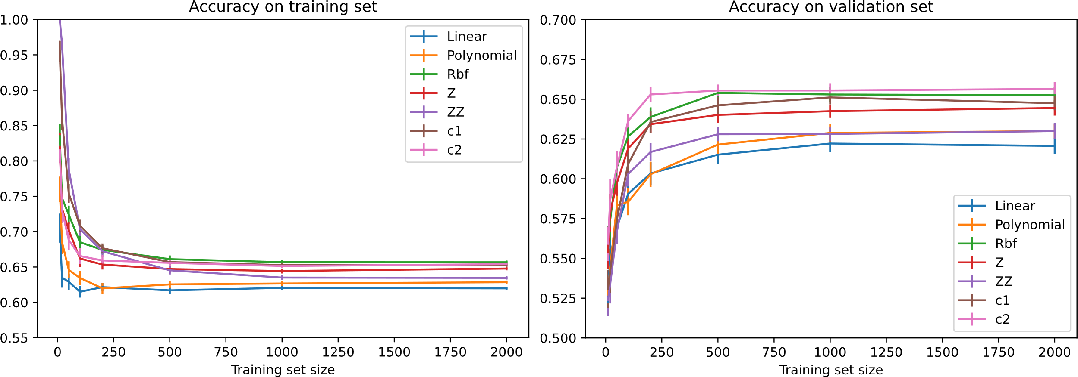
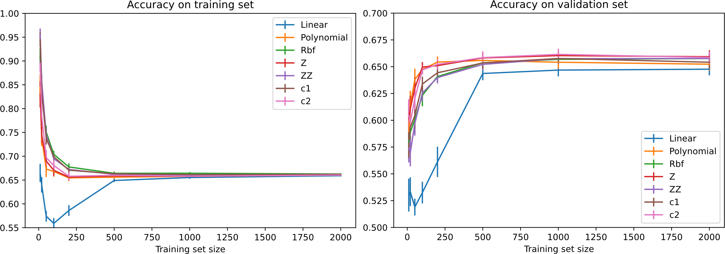
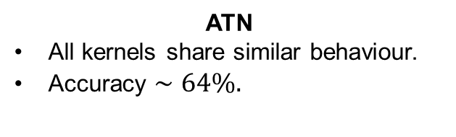
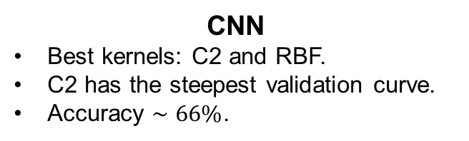
Two-qubits QSVM
Accuracy comparison between SVM and QSVM – two feature case.
CNN
CNN
Classical:
Linear
Polynomial
Rbf
Quantum:
Z
ZZ (ent)
C1 (ent)
C2
CNN
Best kernels: C2 and RBF.
C2 has the steepest validation curve.
Accuracy $∼66\%$.
ATN
ATN
ATN
All kernels share similar behaviour.
Accuracy $∼64\%.$
Ideal QSVMs have been simulated classically

Slide 12
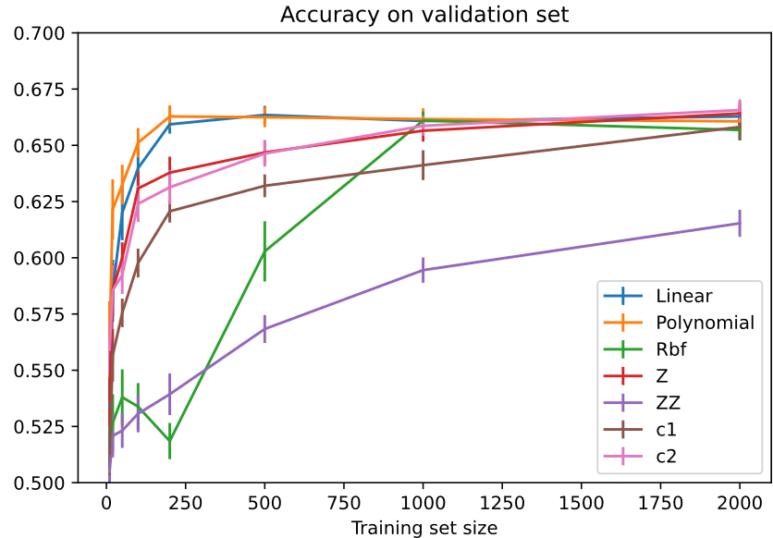
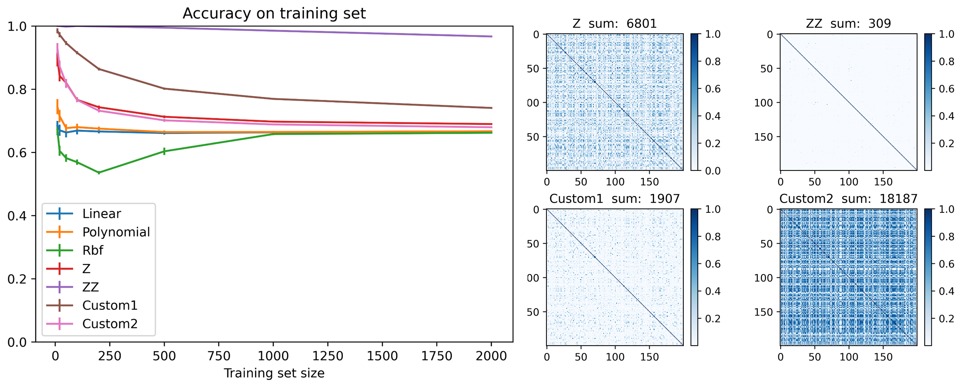


More qubits and the role of entanglement
CNN
More qubits and features have been added to explore larger embedding spaces.
Some Quantum Kernels tends to lose generalizability when increasing the circuit size.
The accuracy on a training set is higher for Quantum Kernels, especially the ones with entanglements.
$→$ Quantum Kernels with entanglement are very expressive, at the risk of overfitting.
10-qubits:
For such kernels, the Gram matrix:
$$G_{ij}=K\left({\vec{x}}_{i}, {\vec{x}}_{j}\right)=〈φ\left({\vec{x}}_{i}\right), φ\left({\vec{x}}_{j}\right)〉$$
CNN
approximates the Identity.
Training accuracies with CNN-extracted features.
Kernel’s Gram matrices.

Slide 13











Genetic Quantum Kernels
Recurring to a binary representation of the quantum feature map circuit, for applying Mutation and Crossover.
Each gate has been described by 6 bits sequences, encoding the gate type and the respective rotation angle.
Rigid constraint: two qubits and three gates per line.
First 3 bits | Gate type
000
001
010
011
100
Last 3 bits | Rotation angle
000
001
010
011
100
Fitness function vs. generation number
→ Maximizing accuracy, preferring smaller circuits for the same classification performance.

Slide 14


Genetic outcome and performances
The Genetic Algorithm produced satisfactory quantum feature maps, giving new insights on the datasets.
CNN
Also entanglement has been premiated
ATN
Only three-gates feature map

Slide 15


QSVM test on IBM hardware
QSVMs were trained with different backends:
Statevector
Access to probability amplitudes.
Qasm simulator
Simulating an ideal circuit behaviour.
Simulated noise
Simulating the noise scheme of a real device.
Real hardware
Remotely running on one of IBM’s devices.
Tested hardware:
ibm_lagos
No evidence of performance loss due to noise.

Slide 16




Enhancing the track resolution
By changing the wire pitch on the toy model dataset, it was possible to highlight three regimes:
$> 5 mm$: CNN outperforms ATN.
Between $5 mm$ and $1 mm$: Transition region.
$< 1 mm$: ATN outperforms CNN.
→ Few hits available: CNN
→ Many hits available, ratio hit number / picture size becomes small $(≲8\%)$: ATN
$$Acc_{CNN}−Acc_{ATN} [\%]$$

Slide 17






DUNE FD Horizontal Drift dataset
Simulation of radiological samples and $0νββ$ events collected at the DUNE Far Detector Horizontal Drift module, accounting for detector effects.
Dominant bkg: 42Ar ($β$ topology).
Subdominant bkg: neutron capture ($n$ topology).
Charges signal at the LArTPC collection plane for radiological background and $0νββ$ events.
CNN has been trained as a binary classifier:
$0νββ−β$: accuracy $∼61\%$.
$0νββ−n$: accuracy $∼70\%$.
Tradeoff efficiency/purity.
$→$Neutron rejection is easier to achieve.

Slide 18


Conclusions
Physics
Modest $ββ$ vs $β$ classification accuracy ($66\%$) for an ideal $5$mm pitch LArTPC.
Slight decrease in DUNE FD Horizontal Drift LArTPC ($61\%$)
→ Depleted argon and better spatial resolution are mandatory.
Better performance in neutron discrimination ($70\%$).
Interesting technique for other low energy physics channels in DUNE.
Preprocessing – Neural Networks
ATN outperforms CNN with high-resolution tracking (pitch $<1 mm$).
CNN outperforms ATN with low-resolution tracking (pitch $>5 mm$).
Quantum classifier – QSVM
Kernel function evaluated with a quantum circuit.
A genetic algorithm provides suitable quantum kernels.
QSVMs have proven to be noise-robust on a 7-qubit IBM processor.
QSVMs matches the classical SVM performances.

Slide 19
Backup

Slide 20






Workflow outline
Binned tracks
…
Feature extraction (CNN/ATN)
Distributions of NN-extracted features (2D case).
Rescaling and outlier removal
Classifier’s decision boundary.
Classical or quantum classifier (SVM/QSVM)
Prediction
$ββ$ (signal) or $β$ (background).

Slide 21



CNN and ATN standalone predictions
Both models have been trained for different number of neurons in the feature layers.
In both cases the accuracies on a validation set don’t depend on the number of extracted features.
It’s possible to give in input to SVM and QSVM just two features without compromising the overall performance
→ suitable for small quantum circuits
CNN
ATN
CNN accuracy: $∼66\%$
ATN accuracy: $∼64\%$

Slide 22


CNN and ATN architectures
CNN
ATN

Slide 23

Bloch sphere visualization
Quantum-encoded feature distribution of heuristic feature maps.
Bloch spheres allows to visualize the degree of class separation.

Slide 24




QSVM at $[1×1×1] {mm}^{3}$
β
CNN
2 qubits
2 features
ββ
ATN
2 qubits
2 features
Topologies start being visible by the naked eye

Slide 25

DUNE low-energy physics

Slide 26


Entanglement - Example
Bell’s pair:

Slide 27


More genetic kernels
6 qubits – 4 features (2 from CNN, 2 from ATN):

Slide 28




DUNE FD Horizontal Drift dataset
Simulation of radiological samples and $0νββ$ events collected at the DUNE Far Detector Horizontal Drift module.
Dominant background: 42Ar ($β$ topology).
Subdominant background: neutron capture.
Charges signal at the LArTPC collection plane for radiological background and $0νββ$ events.
The CNN have been trained with a balanced dataset for classifying signal ($0νββ$) and background ($β+$neutrons).
Accuracy: $∼63\%$
Corresponding to
Efficiency:$∼73\%$ Purity: $∼55\%$

Slide 29



$β$ and neutron background topologies
CNN has been trained to distinguish $0νββ$ from $β$ and from neutrons separately.
Significantly higher performances in neutron rejection.
$→$Neutron topology is easier to identify than $β$.

